Slide 1


Introduction to
Robotic Process Automation
PERSONALIZED STUDY PLANNER BOT
Your Register No. 220701282
Name: SNEKHA R
Guide Name: Mrs. U. Farjana
Designation and Department: Assistant professor
Computer Science and Engineering

Slide 2
Abstract
The Personalized Study Planner Bot is an RPA tool designed to help students manage their study schedules effectively using UiPath.
The bot automates the process of creating and maintaining personalized study plans based on input data such as subjects, deadlines, and preferred study hours.
It allocates study hours dynamically, prioritizing tasks with earlier deadlines or higher importance, ensuring timely completion of academic goals.
The bot tracks progress by monitoring completed study hours, recalculating remaining hours, and adjusting schedules accordingly.
Automated email notifications remind students of upcoming study sessions, keeping them on track and fostering consistency.

Slide 3
Need for the Proposed System
Manual study planning is time-consuming and error-prone.
Students struggle to balance priorities and meet deadlines.
Lack of automated tools for personalized academic planning.
Addresses time management challenges effectively.
An automated system is essential to handle dynamic inputs and adjust schedules as per individual progress and changes.

Slide 4
Advantages of the Proposed System
Reduces manual effort in creating study schedules.
Adapts dynamically to user progress and deadlines.
Sends timely reminders, ensuring no missed sessions.
Provides detailed progress reports for better tracking.
Scalable and integrates seamlessly with existing tools like Excel.

Slide 5
Literature Survey
PAPER 1 : AI Bot for Academic Schedules
ADVANTAGES:
Quick and accurate schedule responses, accessible via smartphones.
Reduces manual effort by automating queries.
DISADVANTAGES
Limited to academic-related queries.
Requires regular updates for schedule changes.

Slide 6
Main Objective
Automate personalized study planning using UiPath.
Collect input (subjects, deadlines, preferences) through Excel.
Schedule study hours dynamically based on priorities.
Send timely email notifications and progress reports.
Foster time management and academic productivity.

Slide 7
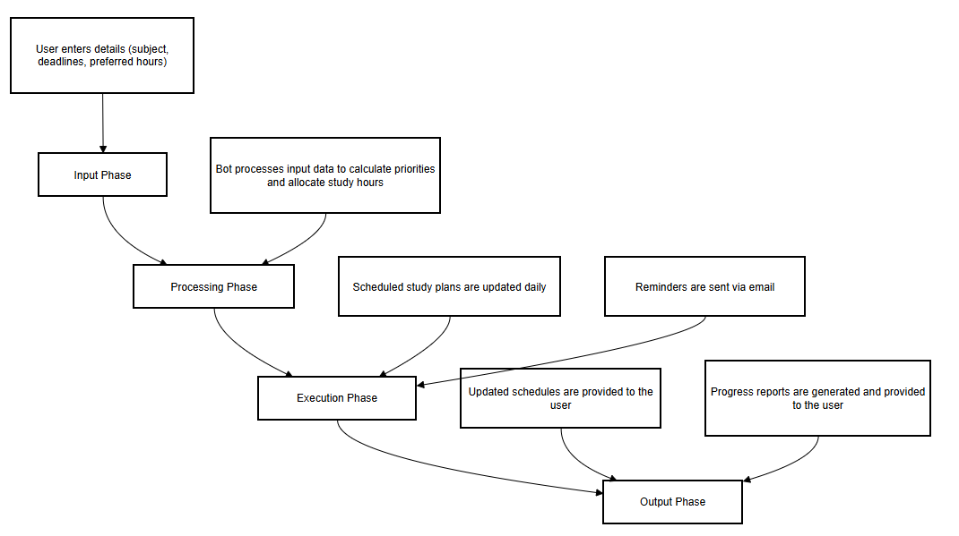
Architecture
Place the Overall structure of the project

Slide 8
System Requirements
Hardware
Processor: Intel Core i5 or higher.
RAM: 8 GB or more.
Storage: 500 GB HDD or SSD.
Software
UiPath Studio.
Microsoft Excel.
SMTP email client.

Slide 9
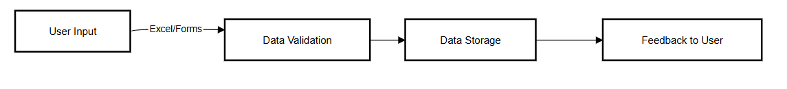
Functional Description
MODULE 1 : Input Handling Module
Import data using UiPath’s Excel activities.
Validate for missing or incorrect information.
Provide feedback for corrections if needed.
DATA FLOW DIAGRAM:

Slide 10
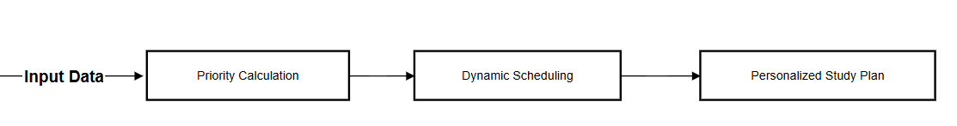
Functional Description
MODULE 2 : Priority Calculation and Scheduling
Use conditional logic for prioritization (e.g., closer deadlines = higher priority).
Calculate scheduled hours dynamically based on preferences.
Adjust scheduling logic in response to updates in progress.
DATA FLOW DIAGRAM :

Slide 11
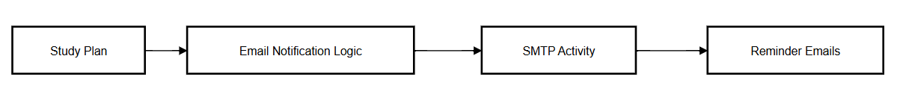
Functional Description
MODULE 3 : Notification and Reminder System
Utilize UiPath’s SMTP activities for automated email sending.
Personalize notifications based on user preferences and priorities.
Schedule reminders dynamically as per the updated study plan.
DATA FLOW DIAGRAM:

Slide 12
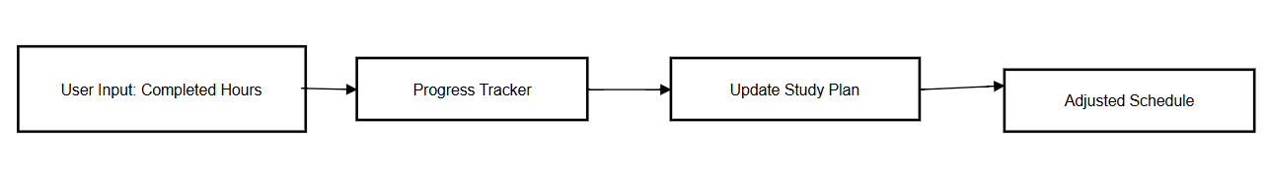
Functional Description
MODULE 4 : Progress Tracking and Adjustment
Prompt users for completed hours using message boxes or forms.
Update progress in the system dynamically.
Adjust future schedules based on current progress and remaining deadlines.
DATA FLOW DIAGRAM:

Slide 13
Table Design
Entities:
Users: UserID, Name, Email.
Subjects: SubjectID, Name, Deadline, Priority.
Schedules: ScheduleID, UserID, SubjectID, AllocatedHours.
Progress: ProgressID, ScheduleID, HoursCompleted.

Slide 14
Process Design
Main Process
Study Planning Automation: Automates the creation, execution, and adjustment of personalized study plans for effective academic management.
Sub Process
Input Collection and Validation: Gathers user inputs (subjects, deadlines, and preferences) and ensures their accuracy.
Dynamic Scheduling: Allocates study hours dynamically based on priorities and deadlines using advanced algorithms.
Notification Handling: Sends automated reminders and progress updates via email to keep users informed.
Progress Tracking: Monitors completed study hours and recalculates schedules to adapt to the user’s progress.

Slide 15
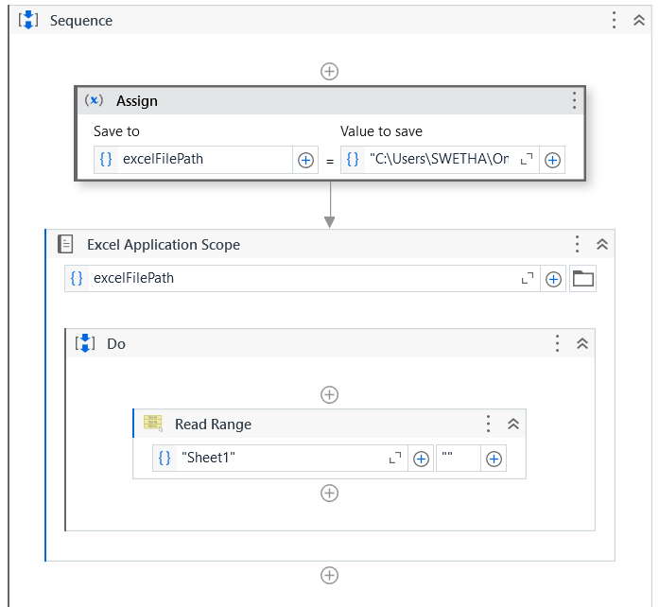
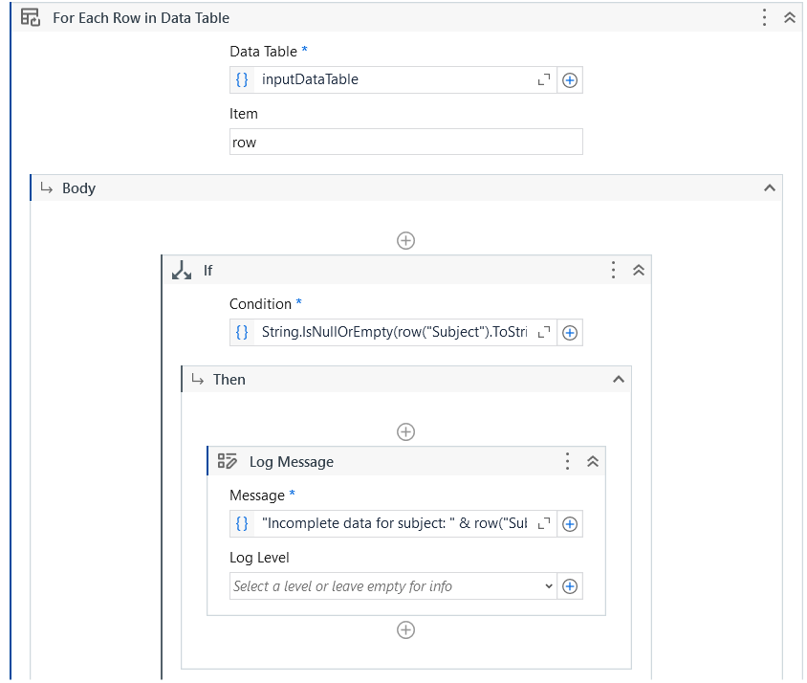
Implementation
INPUT HANDLING MODULE:

Slide 16
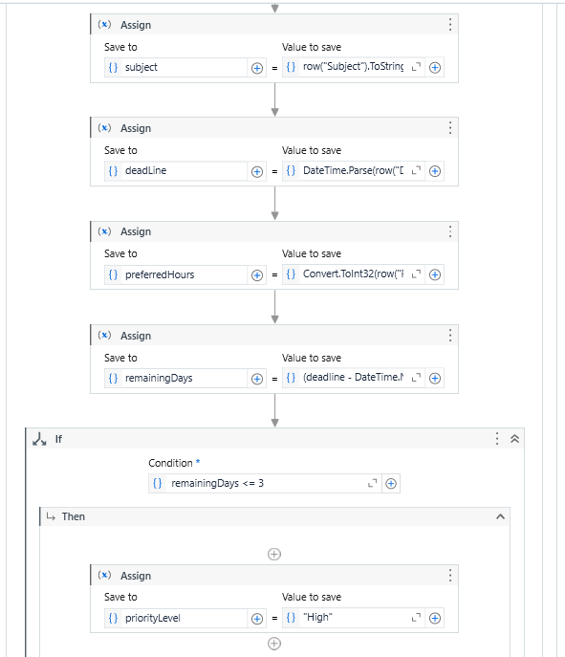
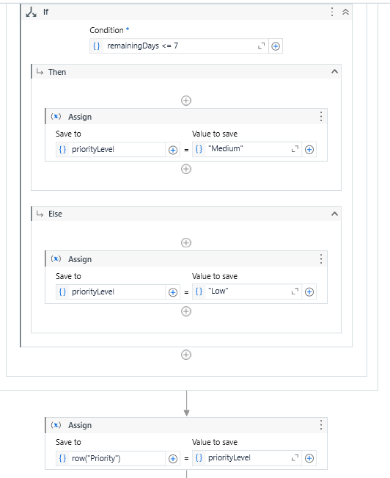
Implementation
PRIORITY CALCULATION AND SCHEDULING:

Slide 17
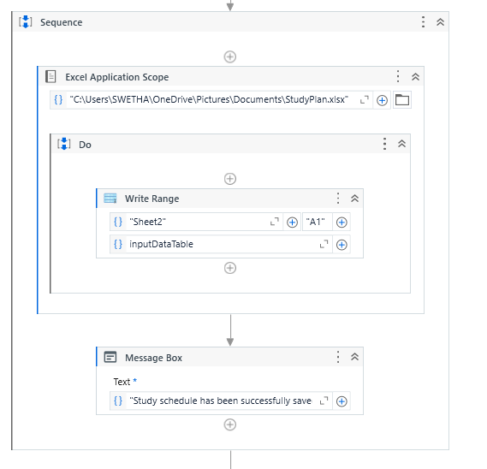
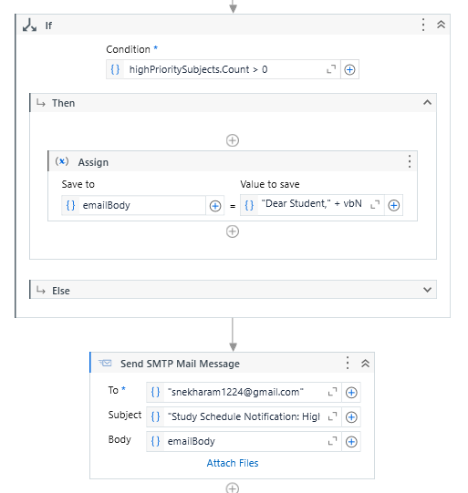
Implementation
NOTIFICATION AND REMINDER SYSTEM

Slide 18
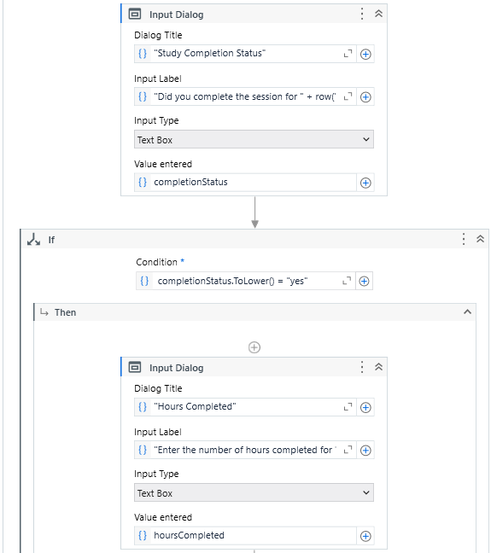
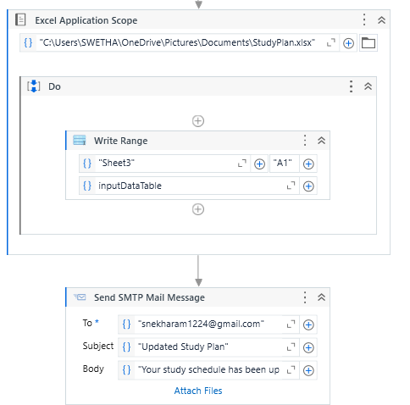
Implementation
PROGRESS TRACKING AND ADJUSTMENT

Slide 19
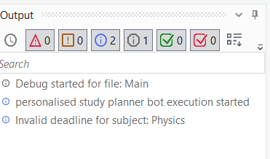
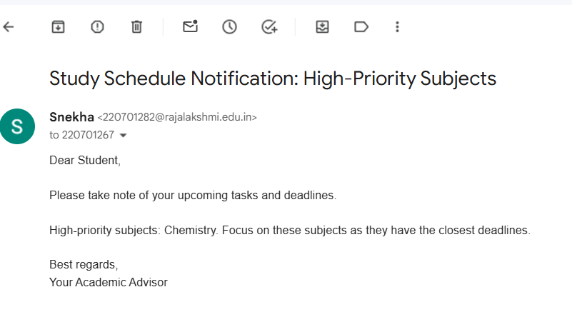
Testing
Verifying data input and validation logic. | Testing schedule updates and email reminders.

Slide 20
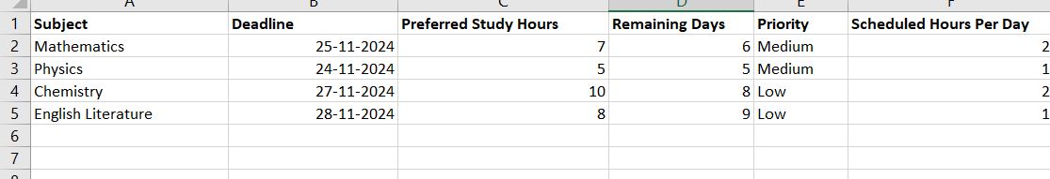
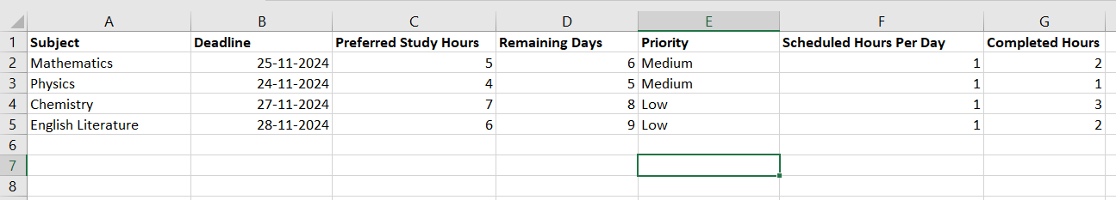
EXCEL STUDY PLAN
Output study plan:
Updated study plan based on completed hours:

Slide 21
Conclusions
Successfully automates personalized study planning.
Reduces manual effort and increases efficiency.
It dynamically adjusts schedules based on progress, ensuring alignment with individual priorities.
Enhances time management and academic productivity.
Seamless integration with tools like Excel and email services makes it user-friendly and widely applicable.

Slide 22
Future Enhancement
RPA Driven Feedback Module
Cloud-based deployment for multi-device support.
Mobile app integration for real-time access.
Multi-System Integration for Holistic Planning

Slide 23
IEEE Paper
AI Bot for Academic Schedules
Authors : Tanya Dinesh; Anala M R; T. Terry Newton; Smitha G R

Slide 24
References
Uipath official documentations Guide.
docs.uipath.com/activities
Excel Automation with UiPath. excelautomation.com
SMTP Mail Automation in UiPath. emailintegration.com
RPA for Education Use Cases. rpaeducation.com
TimeManagement Technique- www.pomodorotechnique.com

Slide 25
Queries

Slide 26
Demonstration

Slide 27
Thank You

